Slide 1
French Restaurant Opportunity in Paris
Luis Escaffi

Slide 2
Background and Hypothesis
Migration to France has grown exponentially, more specifically, to Paris.
The city has turned into a multicultural city.
International restaurants have grown significantly to meet the demand of immigrants.
Is there a lack of French restaurants in any neighborhood in Paris today?

Slide 3
Data Gathering and Cleaning
Foursquare Data: Information on the variety of venues in each of the 20 neighborhoods or "arrondissements" in Paris, France.
Paris Data: Excel spreadsheet with information on latitude, longitude, French population, non-French population, ages, gender, etc.

Slide 4
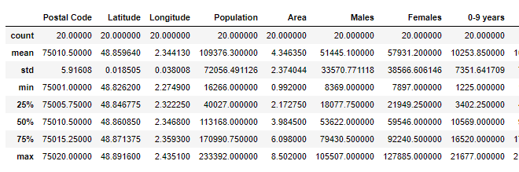
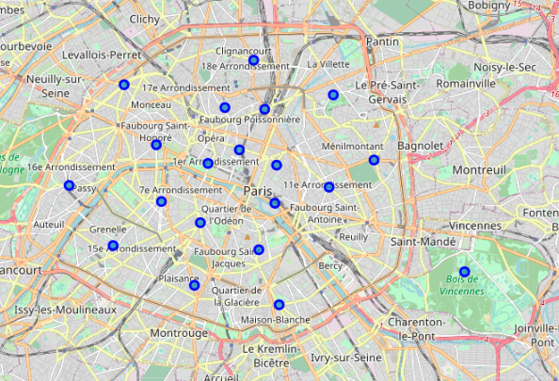
Methodology
Data Cleaning and Descriptive Statistics:
Paris neighborhood mapping:

Slide 5
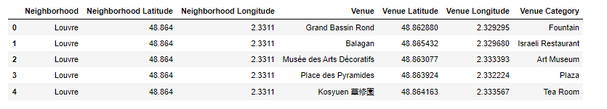
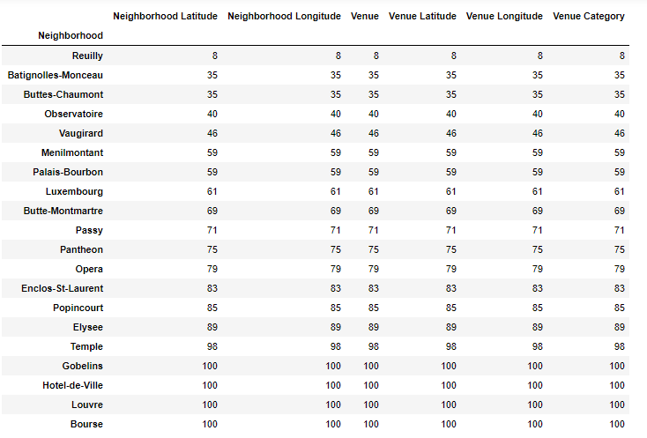
Methodology
Foursquare Data:
Venues by Neighborhood:
Reuilly has the lowest number of venues in its neighborhood – only 8.

Slide 6
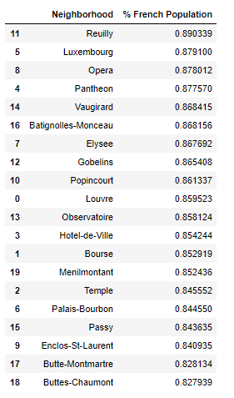
Methodology
French to non-French Population Ratio:
Reuilly has the highest ratio across all neighborhoods (~90% of French people), meaning there may be a high unsatisfied demand in this area.

Slide 7
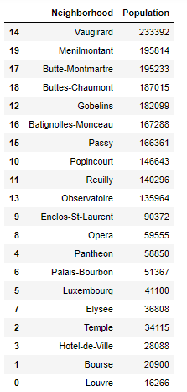
Methodology
Population by neighborhood:
Reuilly is ranked 9th in terms of population (140,296). It is highly above (~30%) the average population of Paris neighborhoods (109,376).

Slide 8
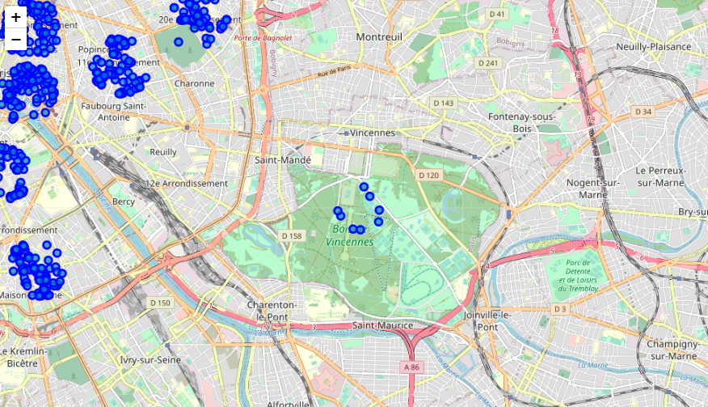
Methodology
Reuilly in a map:
Reuilly is a neighborhood that is slightly away from the heart of Paris.

Slide 9
Results
Reuilly is shown as the neighborhood with the least venues across all neighborhoods in Paris.
Reuilly is the only out of the 20 neighborhoods that doesn’t have French Restaurant as a top 10 venue.
Reuilly ranked first among all 20 neighborhoods in terms of French population meaning there is unsatisfied demand in this area.
Reuilly was ranked 9th in terms of population (140,296), significantly above (~30%) the average population of a neighborhood in Paris (109,376).

